Slide 1
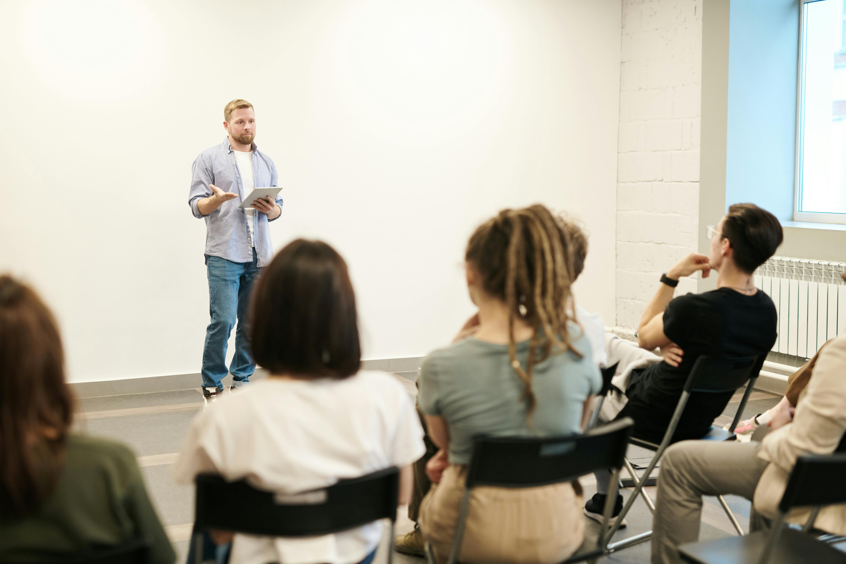
Training
Training for professionals and communities:
Alcohol and Drug Awareness
Emerging Substances and Trends
New Synthetic Opioid Briefings
Vaping
Hidden Harm
County Lines
Exploitation (young people)
Introduction to CGL (service wide presentation)
Harm Reduction Training
Naloxone and Overdose prevention
Introduction to anabolic steroids
Please view our Eventbrite pages for available dates.
For further information or if you need helping finding what you’re looking for you can get in touch.
Notes:
Our training offer builds system-wide capacity by supporting professionals and communities across Manchester in identifying, understanding, and appropriately responding to substance use needs, ensuring a “no wrong door” approach. This includes:
Online training open to everyone bookable via event bright
Face-to-face training for partners who support people who may have drug/alcohol needs

Slide 2
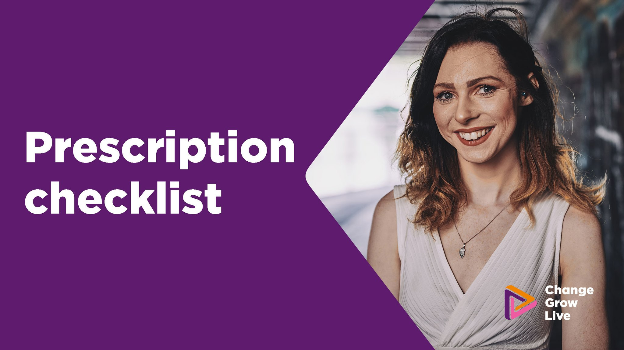
Ways to refer
Online referrals
Telephone referral
www.changegrowlive.org/manchester/
0161 823 6306
Walk in triage
Specialist referrals
Carnarvon Street – M3 1EZ
Mondays 10am – 1pm
Zion Centre – M15 4ZY
Wednesdays 12 – 2pm
Bradnor Point – M22 4TF
Fridays 10am – 1pm
Homelessness
Tuesdays and Thursdays - Mustard Tree
Prison release
Fridays – Mustard Street

Slide 3








Contact details
Please don't hesitate to reach out if you have any questions.
Adult Service
Eclypse Young Persons’ Service
0161 823 6306
0161 823 6306
manchester@cgl.org.uk
eclypsemanchester@cgl.org.uk
www.changegrowlive.org/manchester
www.changegrowlive.org/eclypse/info
Bulletin sign-up form
Bulletin sign-up form

